Slide 1
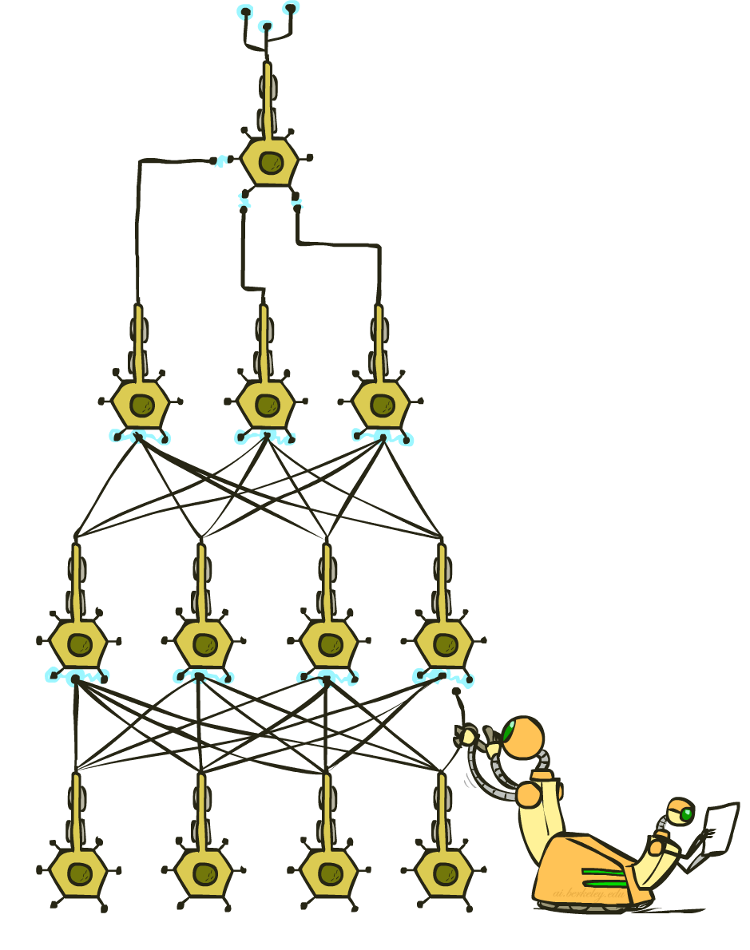
Artificial Intelligence
Deep Learning
Notes:
Please retain proper attribution, including the reference to ai.berkeley.edu. Thanks!
1

Slide 2
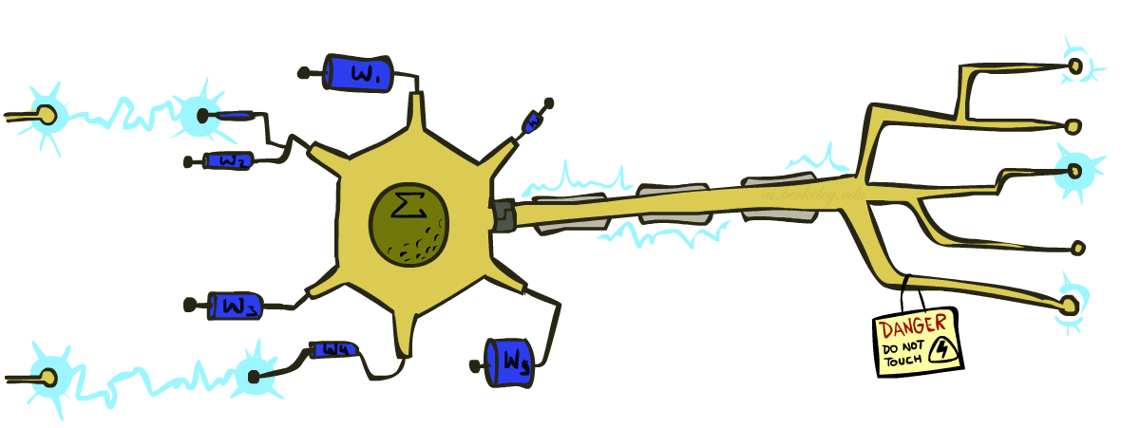
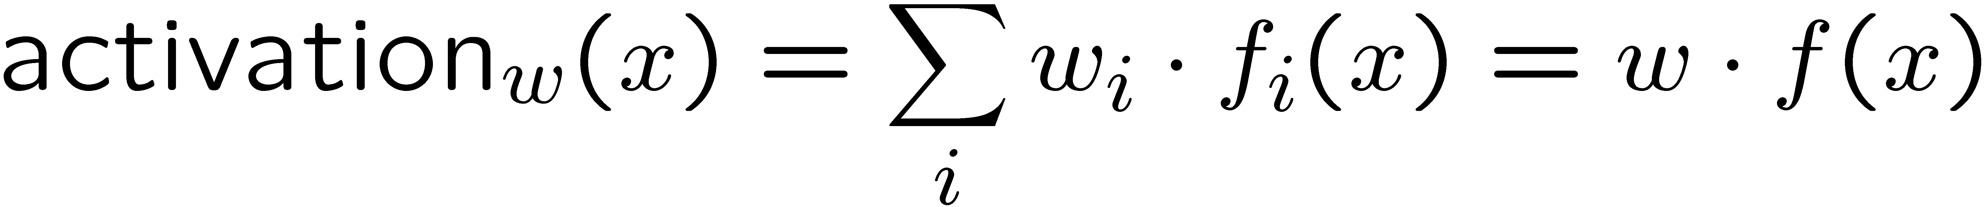
Last Time: Linear Classifiers
Inputs are feature values
Each feature has a weight
Sum is the activation
If the activation is:
Positive, output +1
Negative, output -1
w₁
f₁
Σ
w₂
>0?
f₂
w₃
f₃

Slide 3
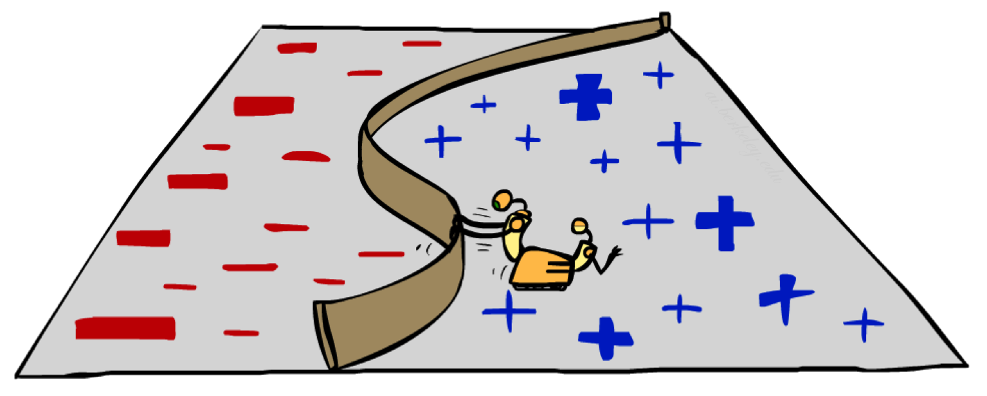
Non-Linearity

Slide 4
Non-Linear Separators
Data that is linearly separable works out great for linear decision rules:
But what are we going to do if the dataset is just too hard?
How about… mapping data to a higher-dimensional space:
0
x
0
x
x²
0
x
This and next slide adapted from Ray Mooney, UT

Slide 5
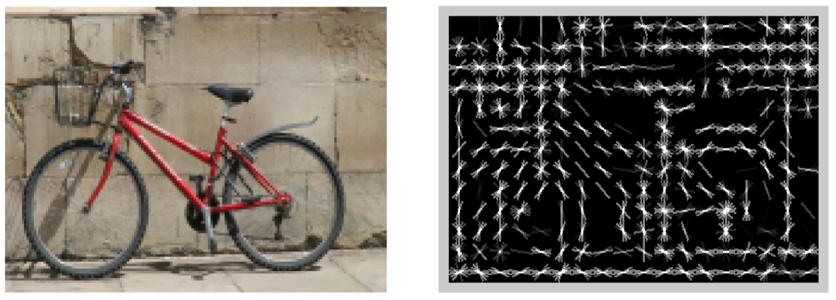
Features and Generalization
Histogram of Oriented Gradients
[Dalal and Triggs, 2005]
Notes:
5

Slide 6
Features and Generalization
Notes:
HoG, SIFT, Daisy
Deformable part models
6

Slide 7
Manual Feature Design → Deep Learning
Manual feature design requires:
Domain-specific expertise
Domain-specific effort
What if we could learn the features too?
Deep Learning
Notes:
7

Slide 8
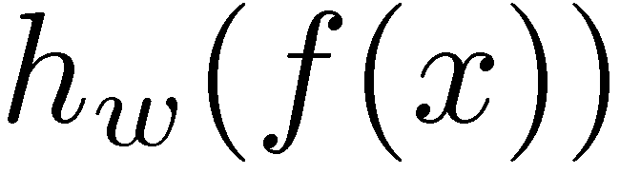
Two-Layer Perceptron Network
w₁₁
Σ
>0?
w₂₁
w₃₁
w₁
f₁
w₁₂
Σ
Σ
w₂₂
>0?
w₂
f₂
>0?
w₃₂
w₃
f₃
w₁₃
Σ
w₂₃
>0?
w₃₃
Notes:
8

Slide 9
Manual Feature Design → Deep Learning
What happens when we arrange linear neurons in a multilayer network?
Nothing
The product of two linear transformations is itself a linear transformation.
We want to introduce non-linearities to the network.
Non-linearities allow a network to identify complex regions in space
Notes:
9

Slide 10
Perceptron vs Neuron
w₁
w₁
f₁
Σ
f₁
Σ
w₂
>0?
w₂
𝞼
f₂
f₂
w₃
w₃
f₃
f₃
Notes:
10

Slide 11
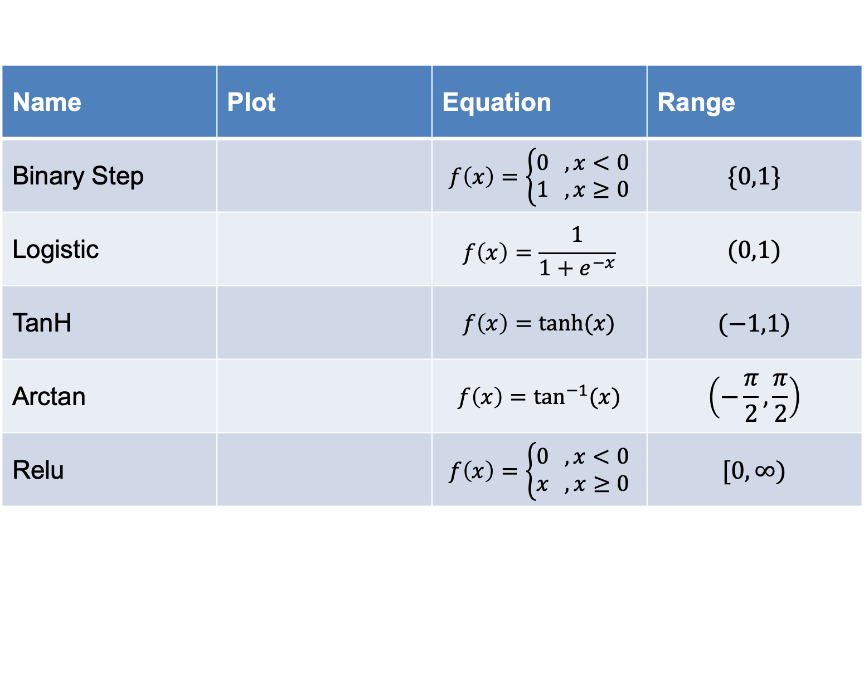
Common Activation Functions
Name | Plot | Equation | Range
Binary Step |  | $$f\left(x\right)=\left\{\begin{aligned}0 , x<0 \\ 1 , x≥0\end{aligned}\right.$$ | $$\{0,1\}$$
Logistic |  | $$f\left(x\right)=\frac{1}{1+e^{−x}}$$ | $$(0,1)$$
TanH |  | $$f\left(x\right)=tanh⁡(x)$$ | $$(−1,1)$$
Arctan |  | $$f\left(x\right)=\tan^{−1}{(x)}$$ | $$\left(−\frac{π}{2},\frac{π}{2}\right)$$
Relu |  | $$f\left(x\right)=\left\{\begin{aligned}0 , x<0 \\ x , x≥0\end{aligned}\right.$$ | $$[0,∞)$$

Slide 12
Two-Layer Neural Network
w₁₁
Σ
>0?
w₂₁
𝞼
w₃₁
w₁
f₁
w₁₂
Σ
Σ
w₂₂
𝞼
w₂
f₂
𝞼
w₃₂
w₃
f₃
w₁₃
Σ
w₂₃
𝞼
w₃₃
Notes:
12

Slide 13
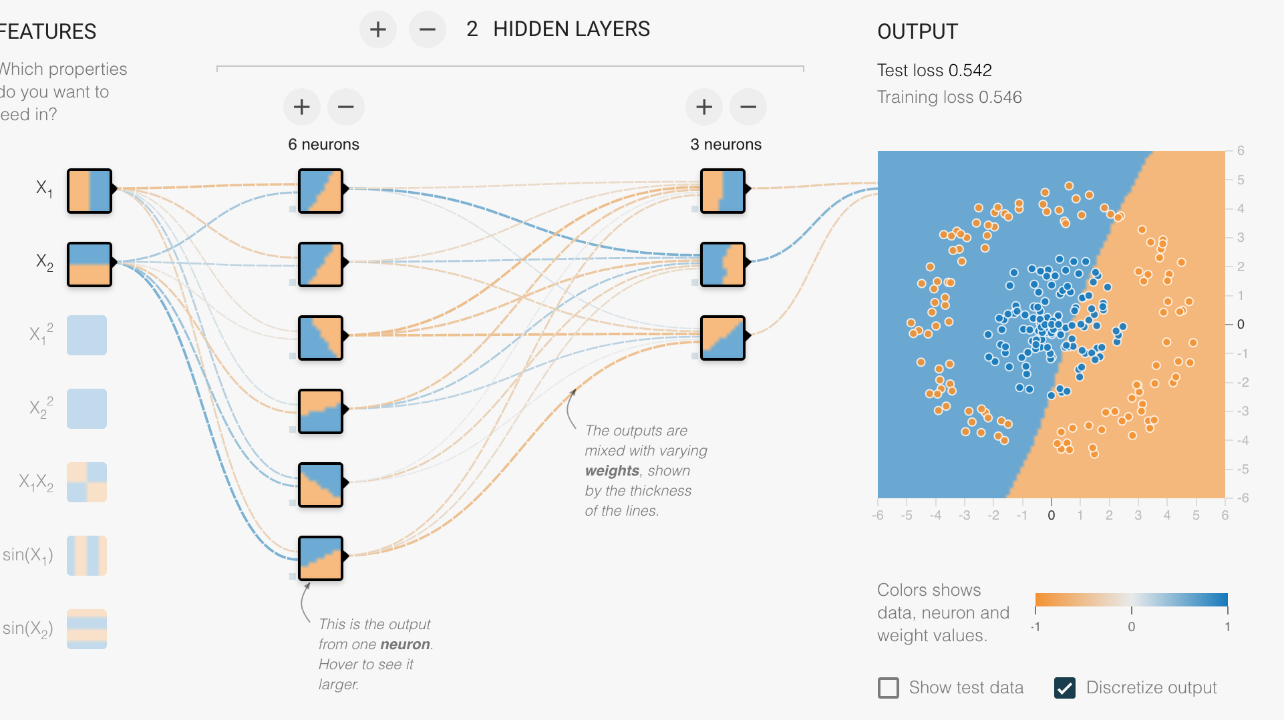
TensorFlow Playground
https://playground.tensorflow.org

Slide 14
Universal Function Approximator
A NN with one hidden layer, can approximate arbitrarily well any functional continuous mapping from one finite dimensional space to another, provided the number of neurons is sufficiently large.
Notes:
14

Slide 15
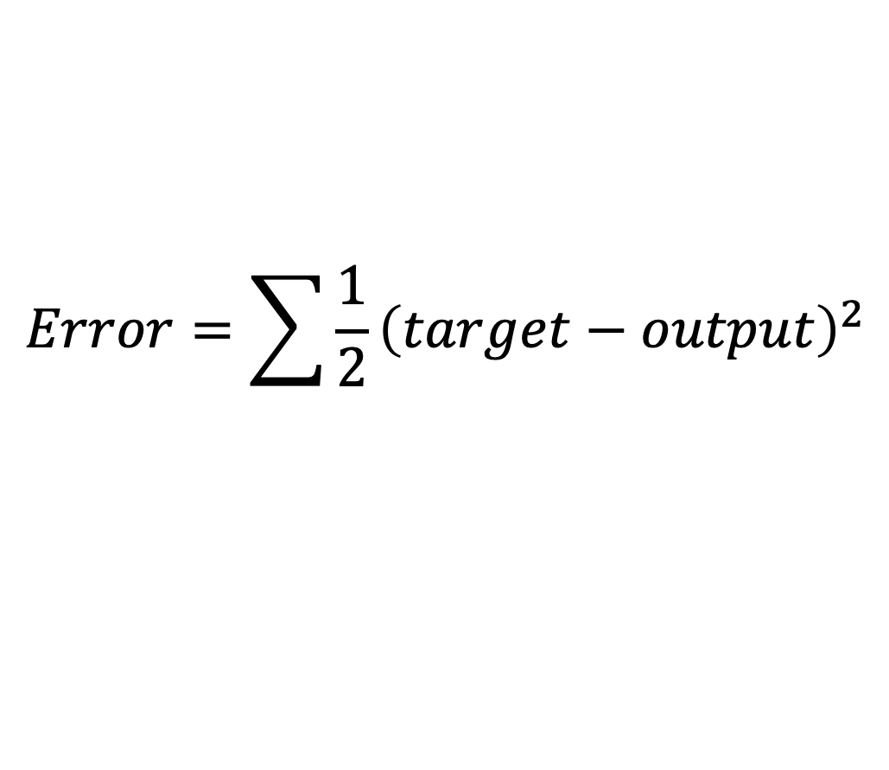
Training
Initialize weights randomly
Feed training data forward through the network and calculate result
Compute error:
Update weights to minimize error
$$Error=\sum{\frac{1}{2}{\left(target−output\right)}^{2}}$$
Notes:
15

Slide 16
1D Error Minimization
Evaluate derivative:
Which tells which direction to step into

Slide 17
1D Error Minimization

Slide 18
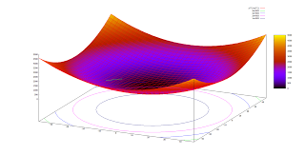
2D Error Minimization
Source: Thomas Jungblut’s Blog

Slide 19
Backpropagation
The algorithm for minimizing the output error
After each training interval …
Compute the derivative of the error function
Adjust weights appropriate direction to minimize error
Notes:
19

Slide 20
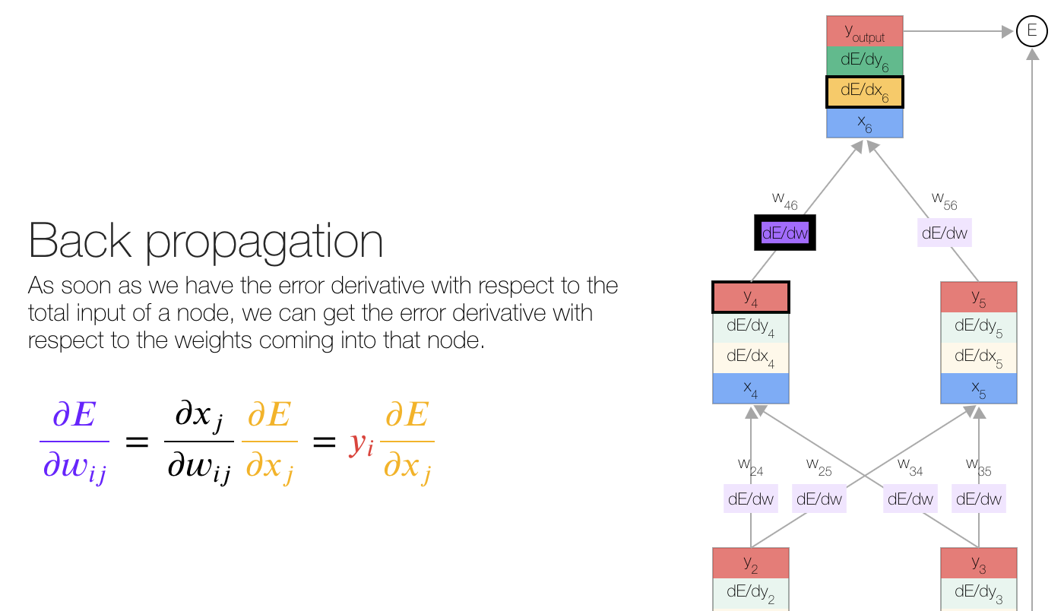
Backpropagation
https://google-developers.appspot.com/machine-learning/crash-course/backprop-scroll/

Slide 21
Deep Dream
https://deepdreamgenerator.com/feed

Slide 22
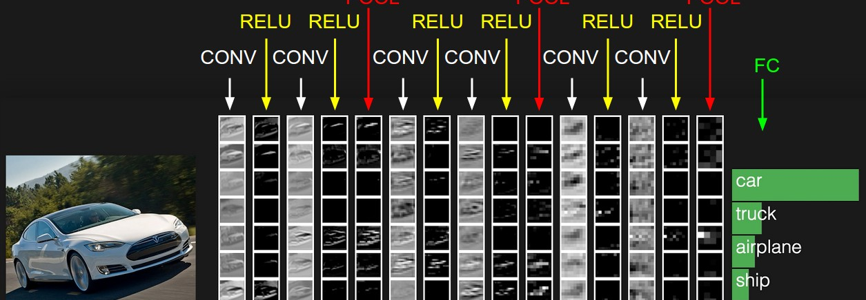
Convolutional Neural Networks
https://cs.stanford.edu/people/karpathy/convnetjs/demo/cifar10.html

Slide 23
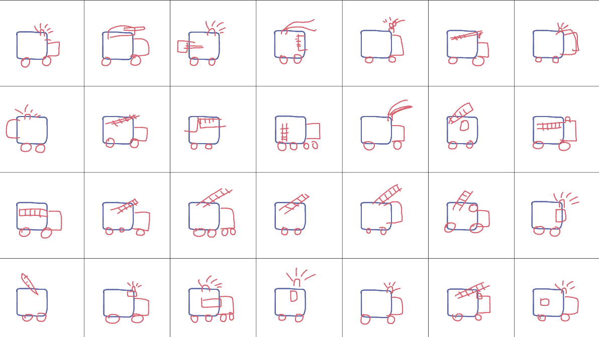
Recurrent Neural Networks
https://magenta.tensorflow.org/assets/sketch_rnn_demo/multi_predict.html

